Slide 1
WEB SCRAPING APPLICATION
By Preeti

Slide 2
AGENDA
What is Web Scrapping
Why it is required
How it works
Applications of Web Scrapping
My Project Details (Amazon Product Data Extractor)
Notes:
QuickStarter has created an outline to help you get started on your presentation. Some slides include information here in the notes to provide additional topics for you to research.

Slide 3
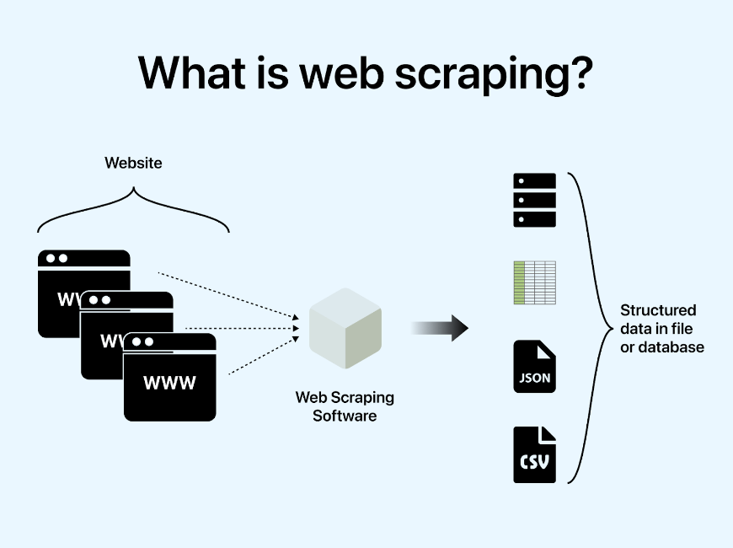
Web Scrapping
WHAT IS IT?
Web scraping is the automatic process of extracting information from a website.
Web scraping technique access the targeted websites through a web browser.
It is a form of copying, in which specific data is gathered and copied from the web, typically into a central local database or spreadsheet, for later retrieval or analysis.
Notes:
QuickStarter has created an outline to help you get started on your presentation. Some slides include information here in the notes to provide additional topics for you to research.

Slide 4
Web Scrapping
WHY?
Access the website and gather the data
It is useful when some website do not have APIs or do not expose APIs for public use and wish to collect data
Web scrapping is not rate limited
Notes:
QuickStarter has created an outline to help you get started on your presentation. Some slides include information here in the notes to provide additional topics for you to research.

Slide 5
Web Scrapping
Web Scrapping
Browser
Access Website
Parse HTML
Locate Element
Fetch the Value
Store Value
HOW IT WORKS?
Access website using http or https
Parse the HTML document
Locate the elements
Fetch/Set the required values
Store the result
Notes:
QuickStarter has created an outline to help you get started on your presentation. Some slides include information here in the notes to provide additional topics for you to research.

Slide 6
Web Scrapping
Applications of Web Scrapping
Job Postings
Extract job posting and internship information
Deal of the Day
Extract offers and discounts
Weather Data
Gather weather data
Price Comparator
Extract product information for comparison
Lead Generation & Marketing
Extract contact details from google maps business listings
Data Analysis
Collect data from multiple websites for analysis purpose
Notes:
QuickStarter has created an outline to help you get started on your presentation. Some slides include information here in the notes to provide additional topics for you to research.

Slide 7
Web Scrapping
Project: Amazon Product Details Extractor using Selenium
Create a new instance of a web driver class
Access the website (amazon.in)
Login to the application by setting username and password
Handle exception explicitly to deal with stale element (try … catch block)
Set the product name in search bar
Extract product information
Window handler to open product specifications page
Notes:
QuickStarter has created an outline to help you get started on your presentation. Some slides include information here in the notes to provide additional topics for you to research.

Slide 8
Web Scrapping
Test Cases
Login with provided username and a password
Home page
Search bar functionality
Enter text in a search text box and click to search
Search with a product and verify search results
Product details – click on a product
Product details – verify the specifications along with a price
Search with a not available product text and look at the results (should be product not found)
Notes:
QuickStarter has created an outline to help you get started on your presentation. Some slides include information here in the notes to provide additional topics for you to research.

